Slide 1
Session #7: In-Context Learning:
Tuesday, Sept 20
CSCI 601.771: Self-supervised Statistical Models

Slide 2
This paper is really good at ___ but fails to address ___

Slide 3
Rethinking the Role of Demonstrations: What makes In-context learning Work?
Flow of the presentation:–
Background (MetaICL, Noisy, and direct inference in brief)
What is the article trying to answer?
Design of the Experiments (What is their approach?)
Results
Discussion and Conclusions
✍️: Ammar and Karan

Slide 4
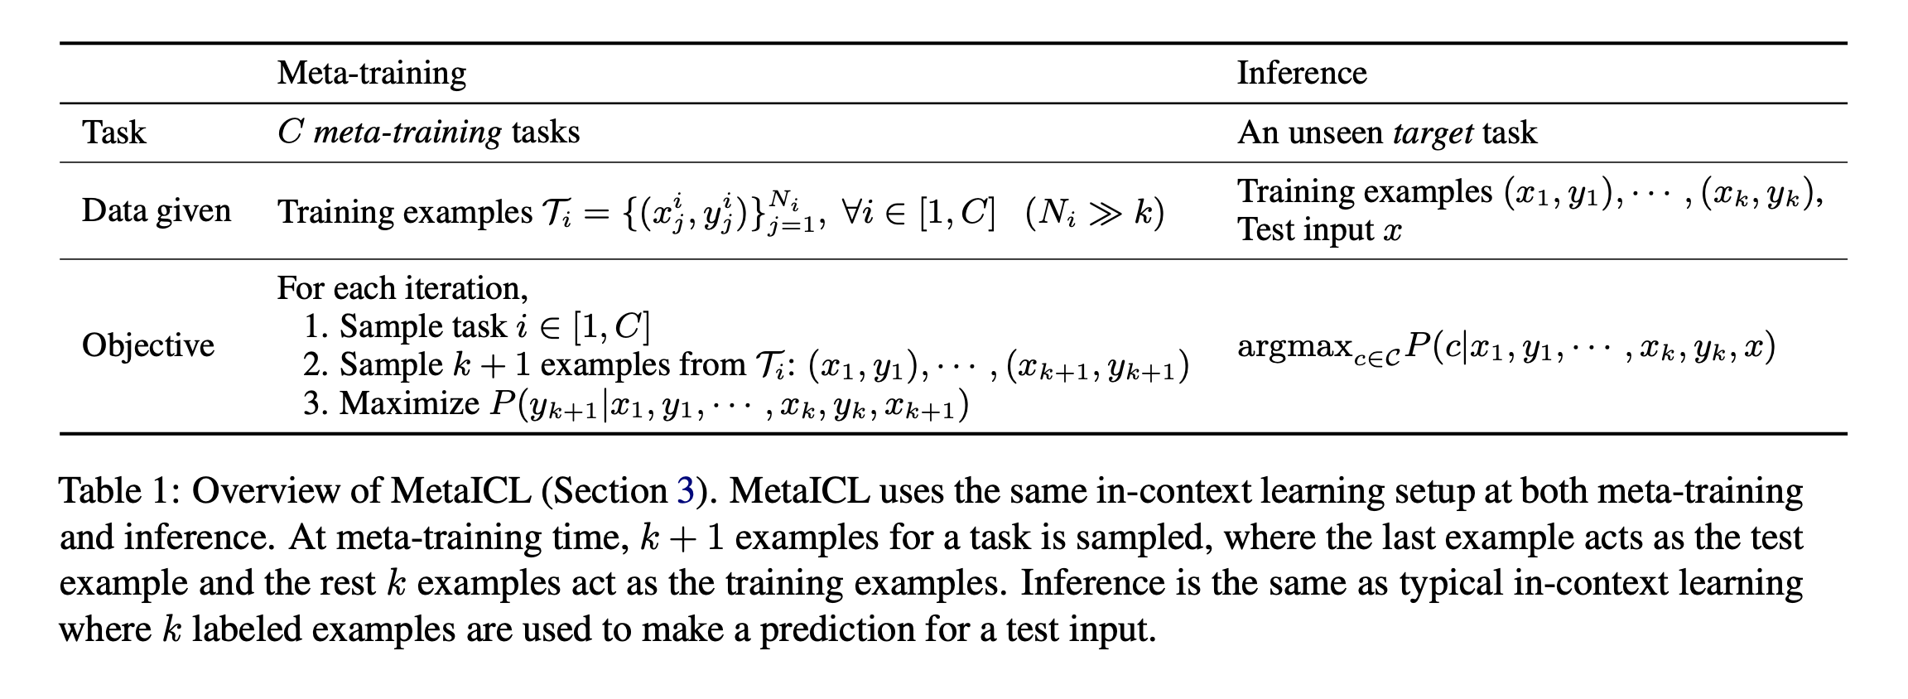
Background
What is Meta learning?
✍️: Ammar and Karan

Slide 5
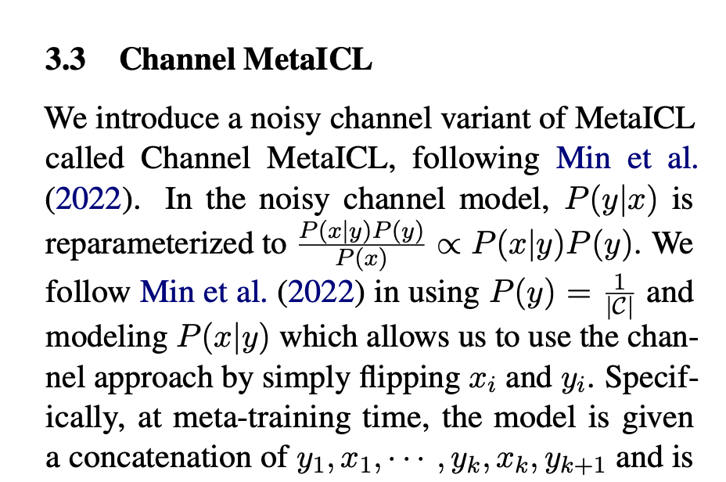
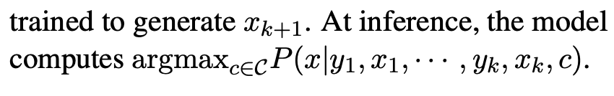
Background
What is Noisy/Channel Vs Direct Inference(what we normally do)?
✍️: Ammar and Karan

Slide 6
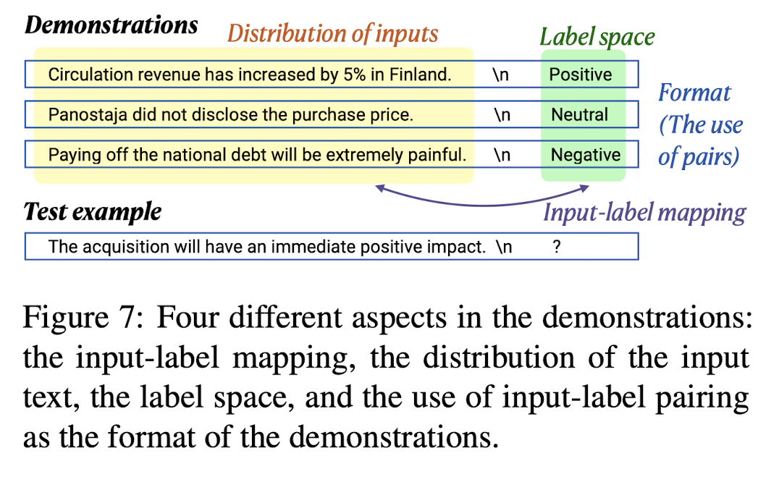
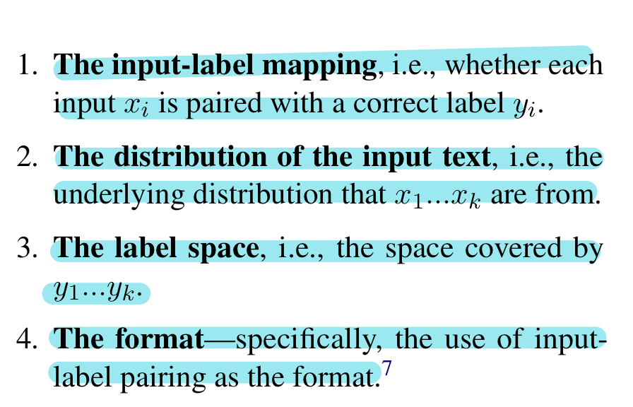
What is article trying to answer?
The article is trying to empirically find the the importance of demonstrations (conditions) for in-context learning
✍️: Ammar and Karan

Slide 7
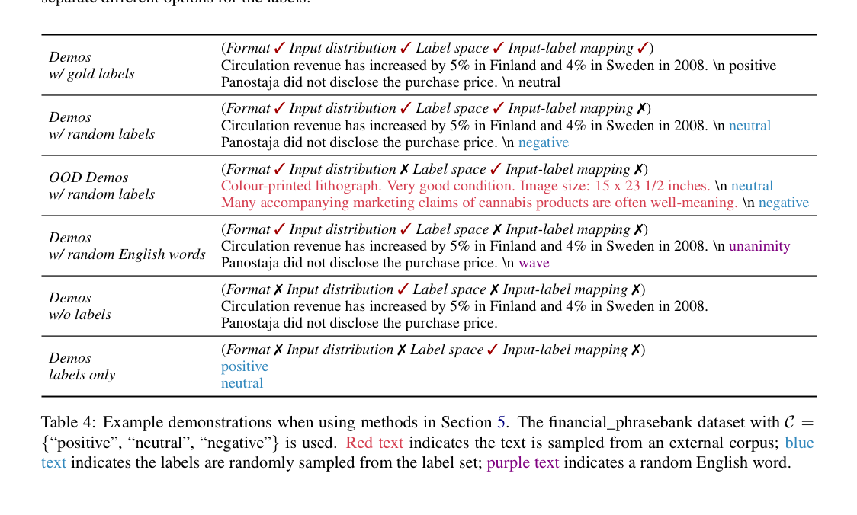
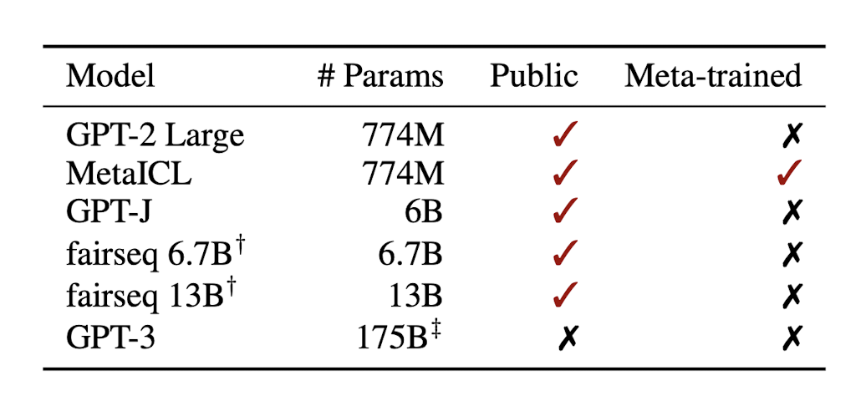
Design of the Experiments
6 LMs (12 decoder-based models, which are a variation of the 6 LMs)
Different number of tasks specific to experiment
Accuracies averaged locally and grouped (classification and multi-choice)
Main experiment Ideas
✍️: Ammar and Karan

Slide 8
Results
✍️: Ammar and Karan

Slide 9
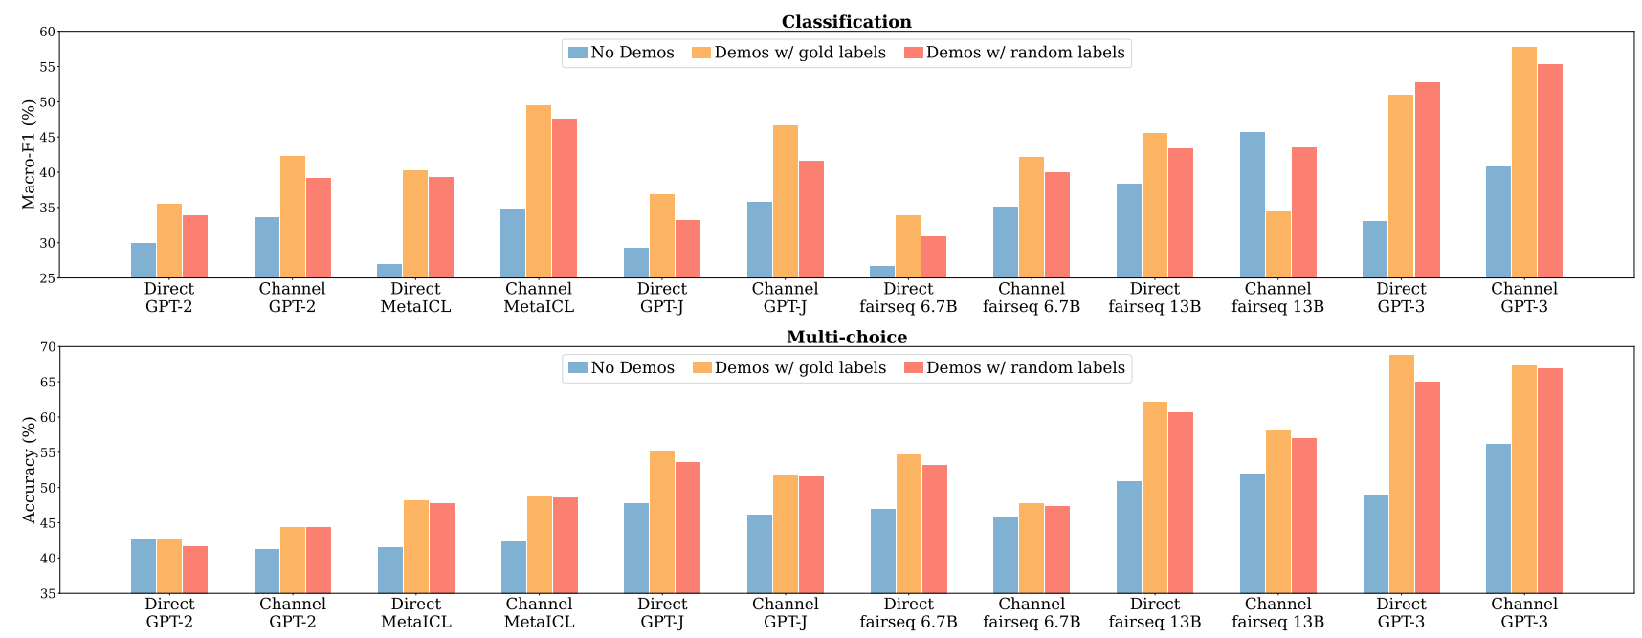
Ground Truth Matters Little
Replacing gold labels with random labels only marginally hurts performance
✍️: Ammar and Karan

Slide 10
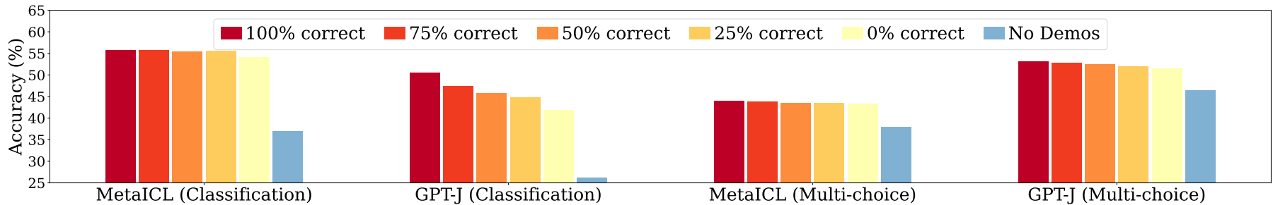
Does the Number of Correct Labels Matter?
Model performance is fairly insensitive to the number of correct
labels in the demonstrations
✍️: Ammar and Karan

Slide 11
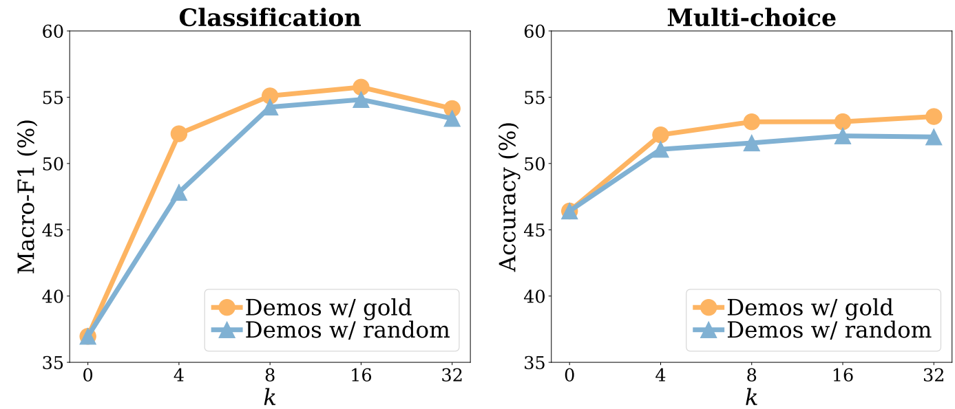
Does Varying K Matter?
Model performance does not increase much as k increases when k ≥ 8, both with gold labels and with random labels
✍️: Ammar and Karan

Slide 12
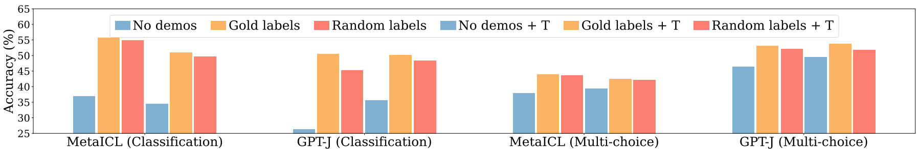
Is the result consistent with better templates?
The trend—replacing gold labels with random labels barely hurting performance—holds with manual templates
✍️: Ammar and Karan

Slide 13
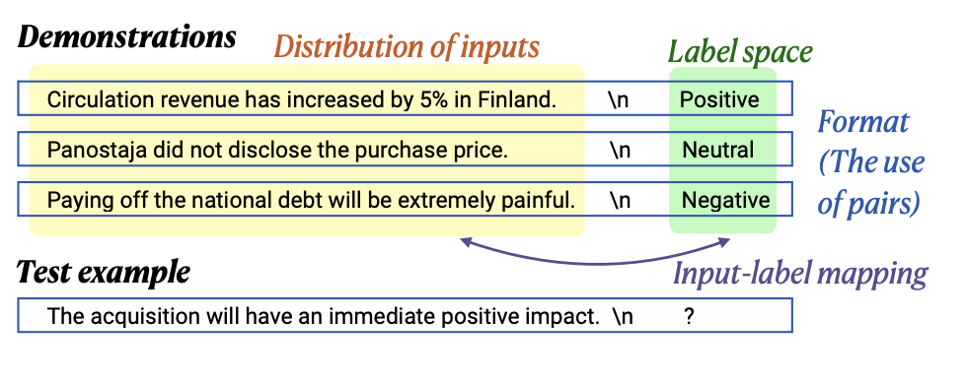
Why does in-context learning work?
✍️: Ammar and Karan

Slide 14
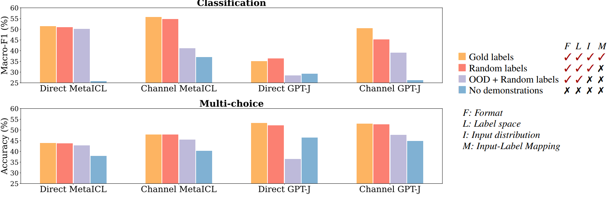
Impact of the distribution of the input text
In-distribution inputs in the demonstrations substantially contribute to performance gains
✍️: Ammar and Karan

Slide 15
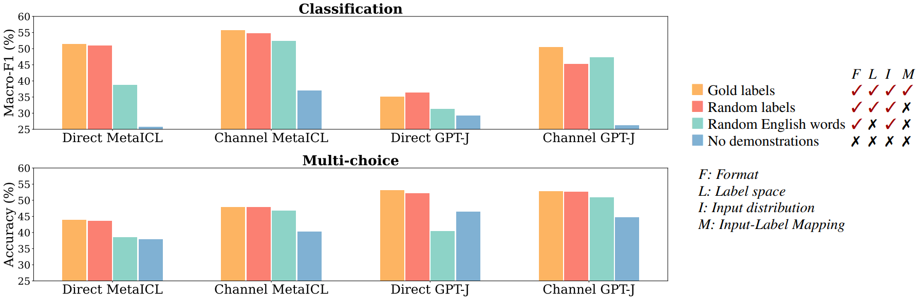
Impact of the label space
Conditioning on the label space seems to significantly contribute to performance gains only for direct models.
✍️: Ammar and Karan

Slide 16
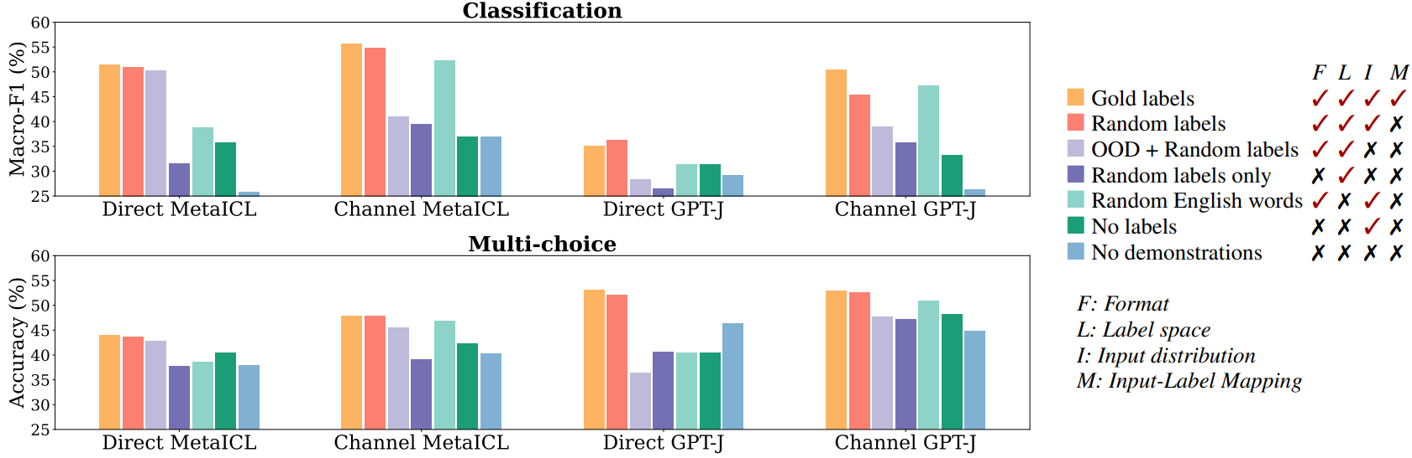
Impact of the use of input-label pairing
Keeping the format of the input-label pairs is the key.
✍️: Ammar and Karan

Slide 17
Discussion and Conclusion
Three main conclusions
Accuracy gains are mainly coming from independent specification of the input space and the label space
The models can still retain up to 95% of performance gains by using either the inputs only or the label set only if the right format is used
meta-training with an in-context learning objective magnifies these trends (as it forces the model to exploit simpler details in the demonstrations)
✍️: Ammar and Karan

Slide 18
Discussion and Conclusion
Discussions
Does the model learn at Test time? (Not strictly, it learns a simple map for a task)
Capacity of LMs. (demonstrations are for task location and the intrinsic ability to perform the task is obtained at pretraining time)
Just using random input-label pairs as demonstrations improve performance. Does this mean the model has a higher zero shot learning capacity then we thought?
✍️: Ammar and Karan

Slide 19
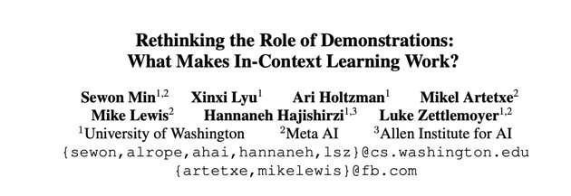
A review of the Paper
🔎: Ayo Ajayi, Elisee Djapa, Yongrui Qi

Slide 20
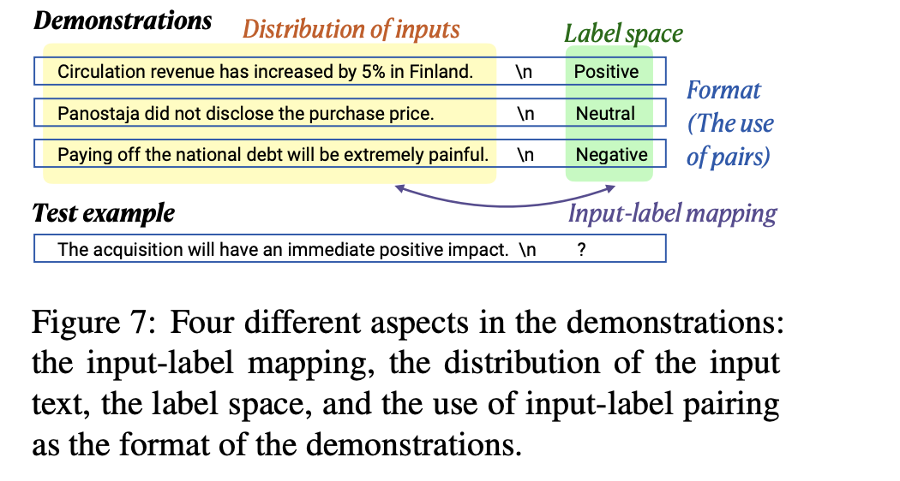
Paper Summary
How in-context learning works
Demonstration
Label space
Input distribution
Sequence format
Main results show that input label mapping is not important to in-context learning.

Slide 21
Positives
Empirical paper
Explains how and why in-context learning works.
Could be useful for anyone trying to incorporate in-context learning within their LM.
Lots of background research.
Explains how and why datasets were chosen.
Diverse datasets (covers topics on science, social media, and finance) supported by GLUE and SuperGLUE benchmarks.
Low resource data sets, good for reproducibility (size of datasets)
Capacity of Large Model

Slide 22
Negatives
Why use decoder-only models?
Lack of explanation in methodology: why direct and channel methods?
What exactly is meta learning and its impact?
How does demonstration contribute to models?

Slide 23
Visionary: Conclusion
In-context learning doesn't depend on the association between input and annotation, but the ability to activate pre-trained models by presenting them in the form of data.
Proved that model does not rely on the ground truth input-label mapping as much as we thought (replacing the labels in demonstrations with random labels barely hurts performance)
🔭: Haoyue, Fadil

Slide 24
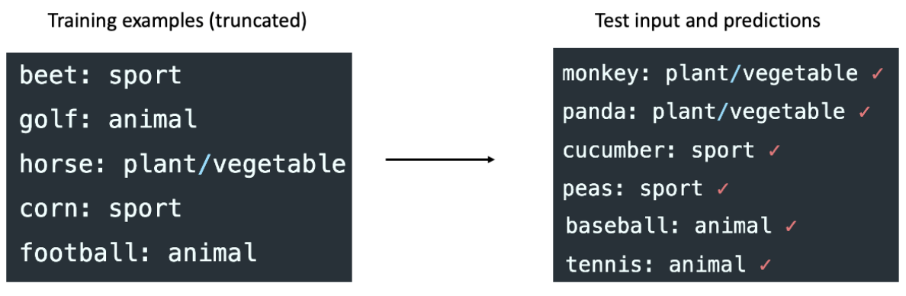
Unnatural In-context learning
Model is “localizing” or “retrieving” concepts that it has learned during pretraining, thus it can perform unnatural/unseen synthetic task with in-context learning.
🔭: Haoyue, Fadil

Slide 25
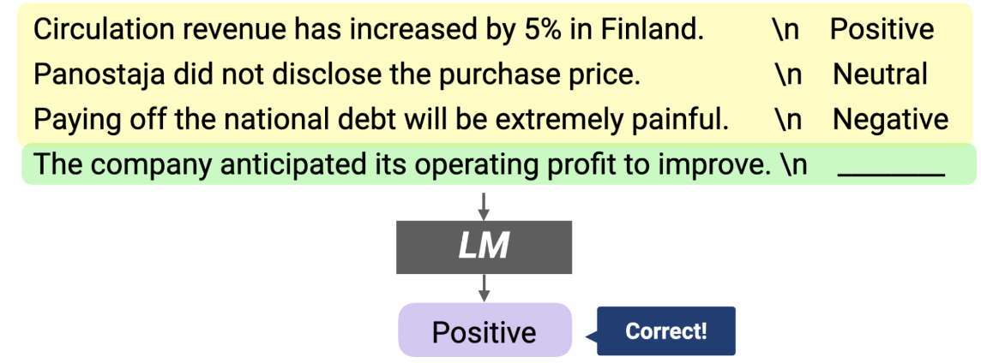
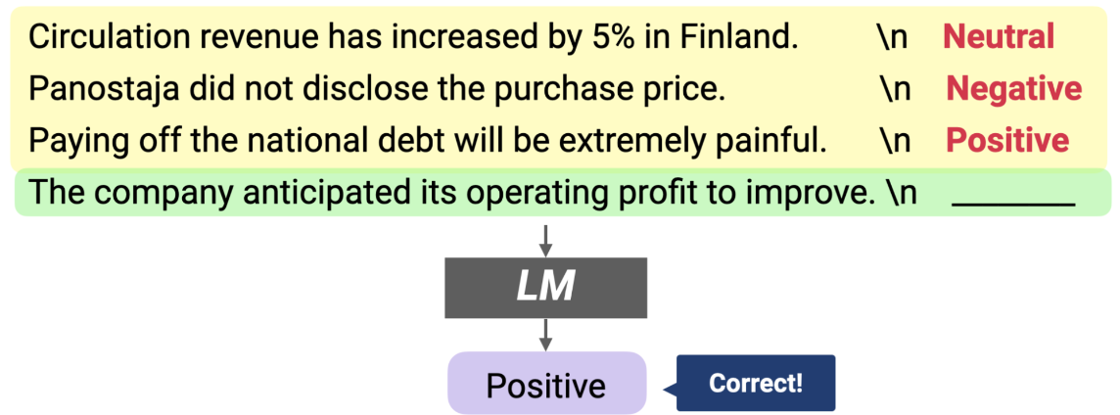
Zero-shot performance improvement
Possible to achieve nearly k-shot performance without using any labeled data!
You can simply pairing each unlabeled input with a random label and using it as the demonstrations.
Raise zero-shot baseline level up to 20% absolute in classification and up to 15% absolute in multi-choice tasks.
🔭: Haoyue, Fadil

Slide 26
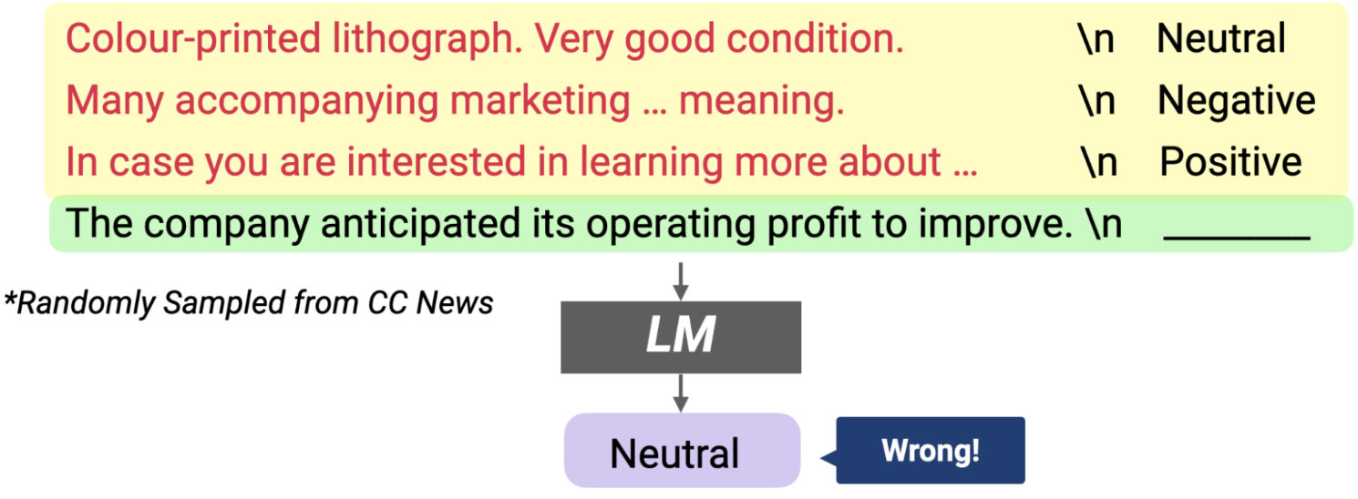
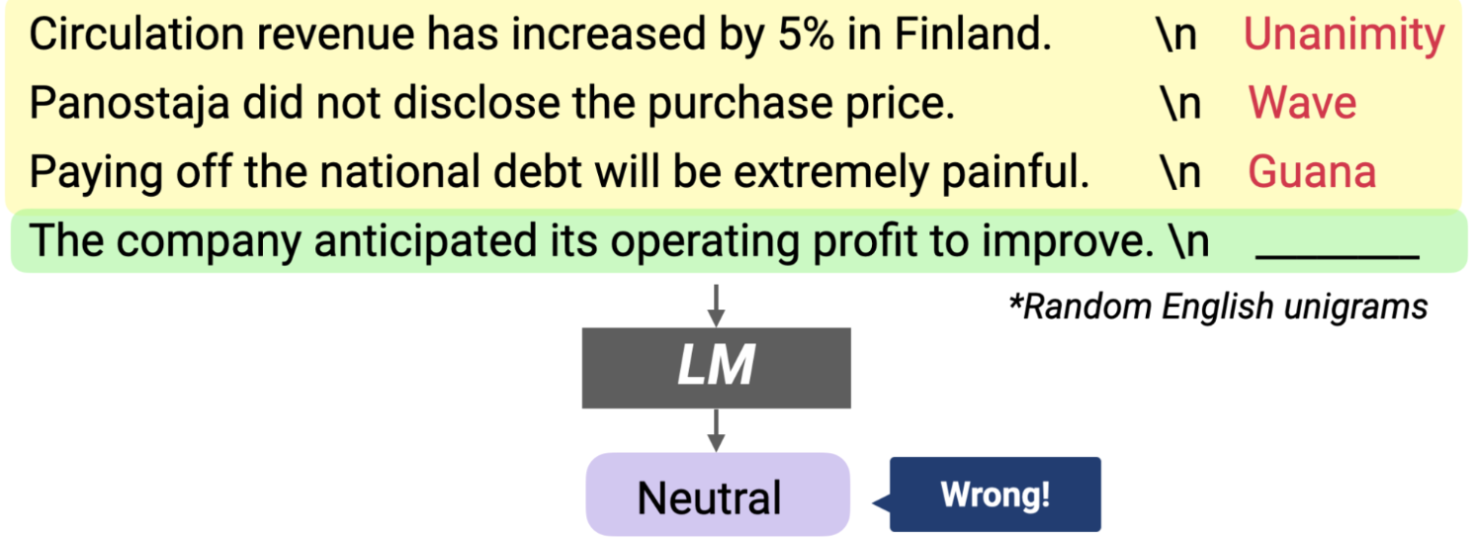
Watch Out!
Prompts randomly sampled from an external corpus are detriment to the model
Need to care about the choice of demonstrations. (same/close input distribution)
External Corpus
Random Unigrams
🔭: Haoyue, Fadil

Slide 27
Complementary Work - Instruction following model
Multitask Prompted Training Enables Zero-Shot Task Generalization, 2022 ICLR
A total of 171 multitasking datasets were collected and a total of 1939 prompts were created, with an average of 11.3 prompts per dataset.
Multi-task learning based on datasets containing instruction prompt (prompt form is more like an explicit command/instruction)
🔭: Haoyue, Fadil

Slide 28
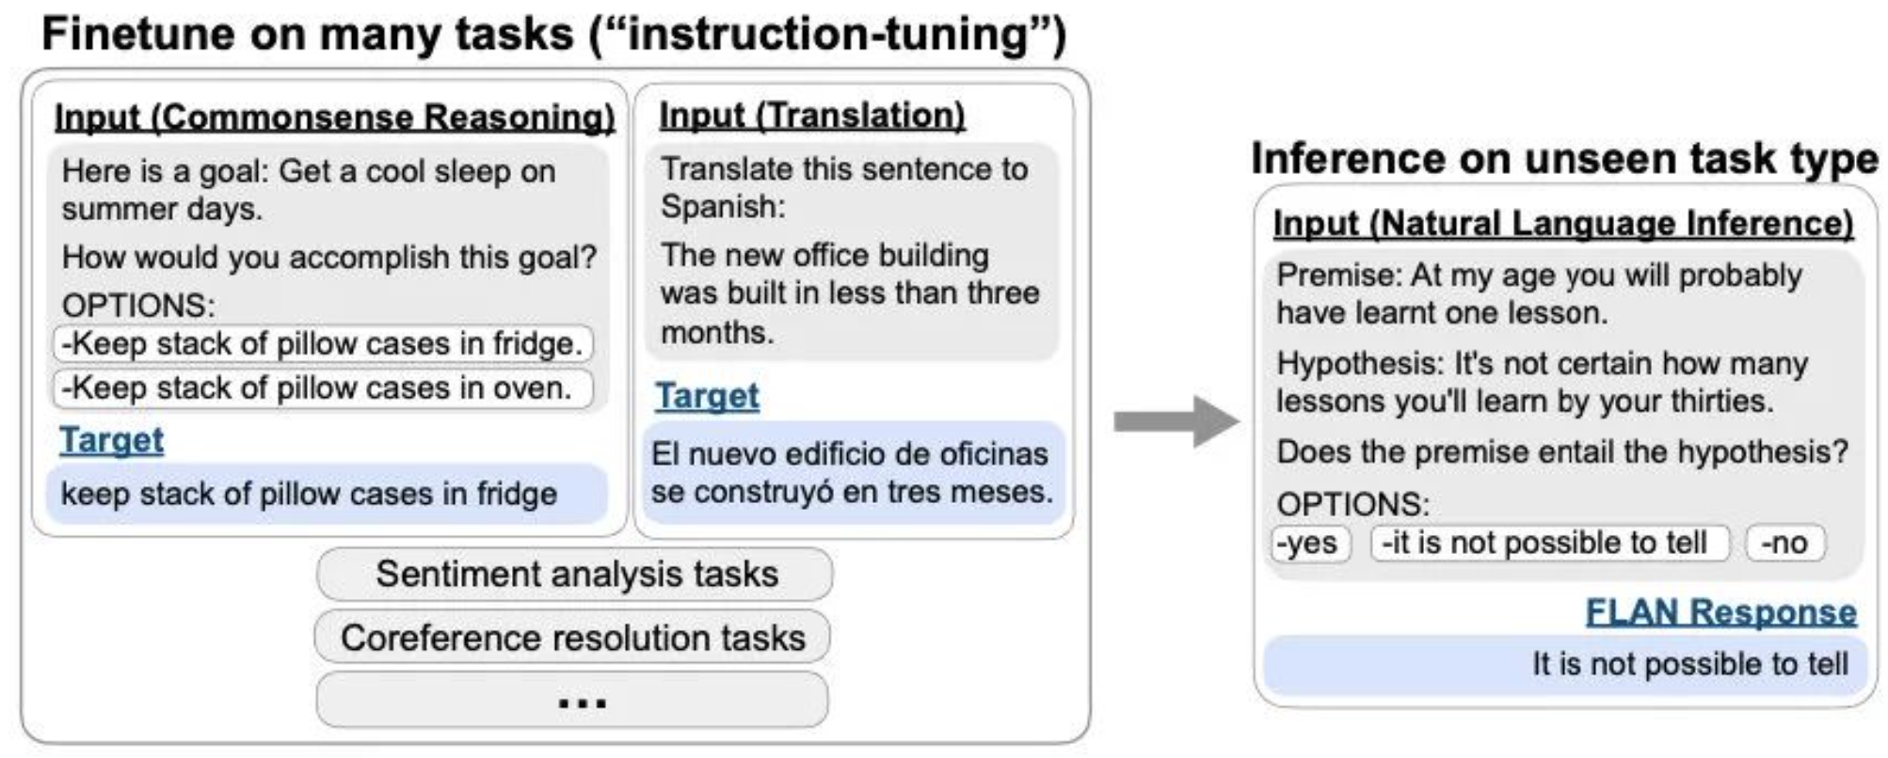
Complementary Work - Instruction following model
🔭: Haoyue, Fadil

Slide 29
Complementary Work - Instruction following model
Why important?
The demonstrations and instructions largely have the same role to LMs, and the author hypothesizes that the findings hold for instruction-following models.
Why hypothesize is true?
The instructions prompt the model to recover the capacity it already has, but do not supervise the model to learn novel task semantics.
🔭: Haoyue, Fadil

Slide 30
Future Work
Investigate how does model scale, training objective, and architecture affect the model behavior during in-context learning.
The author also post other related works, experiments are overlapped
Noisy Channel Language Model Prompting for Few-Shot Text Classification
MetaICL: Learning to Learn In Context
🔭: Haoyue, Fadil

Slide 31
Using the methodology for FSL (And perhaps OSL?)
Computer Vision
Robotics
Audio processing
🔭: Haoyue, Fadil

Slide 32
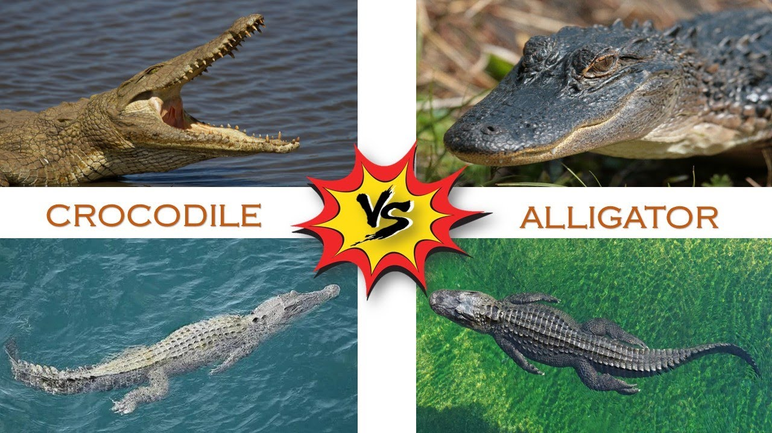
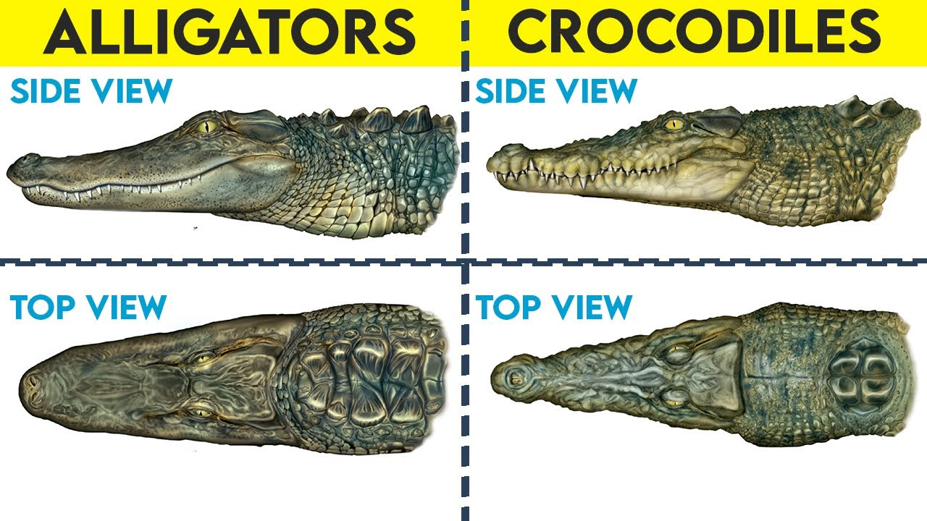
Alligator vs Crocodile

Slide 33
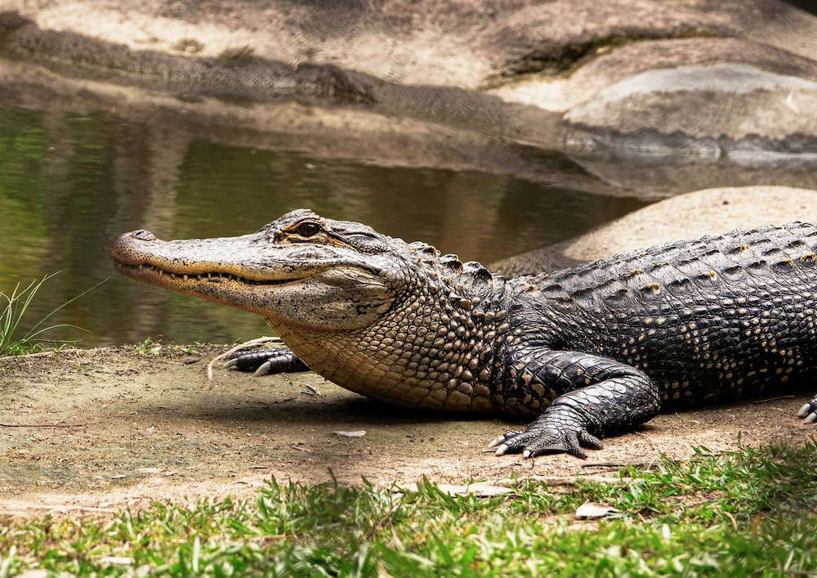
What is this?

